Slide 1
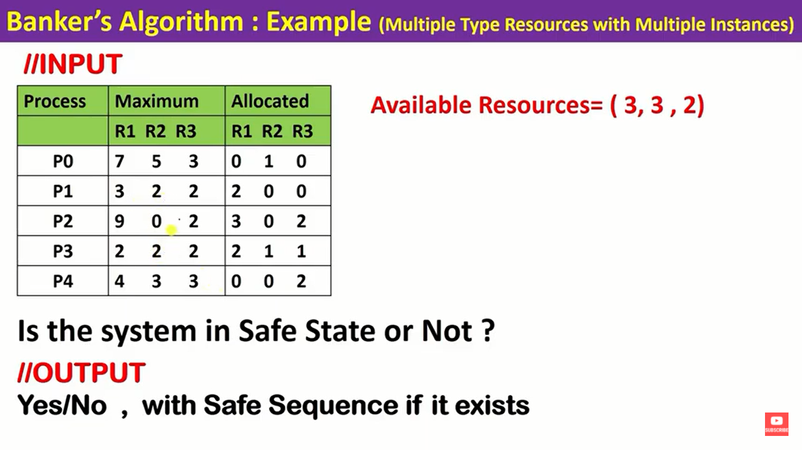

Slide 2
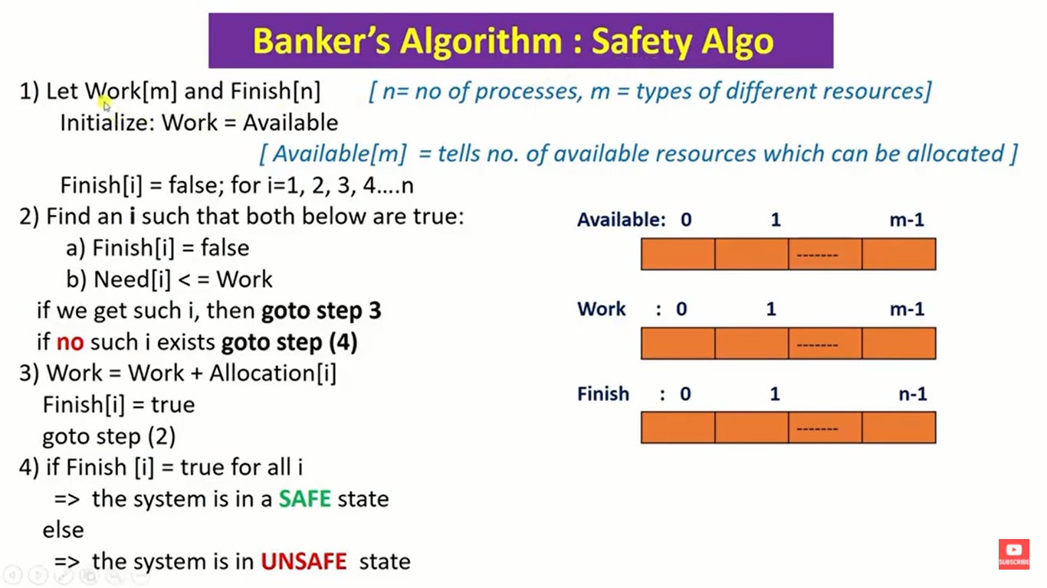

Slide 3
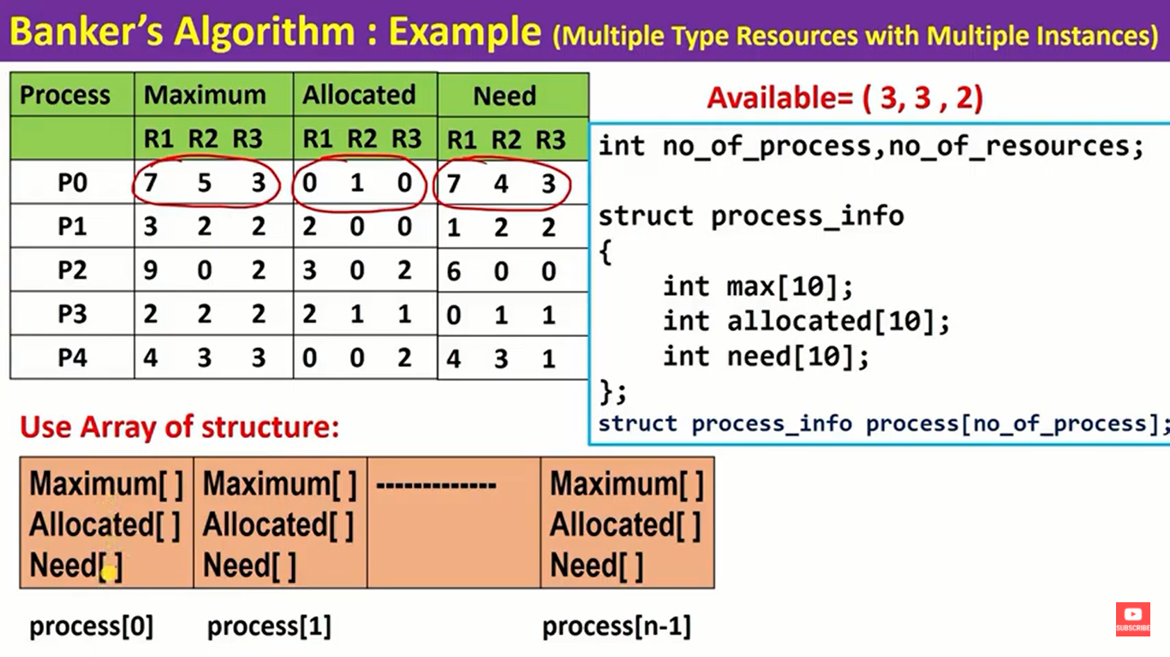

Slide 4
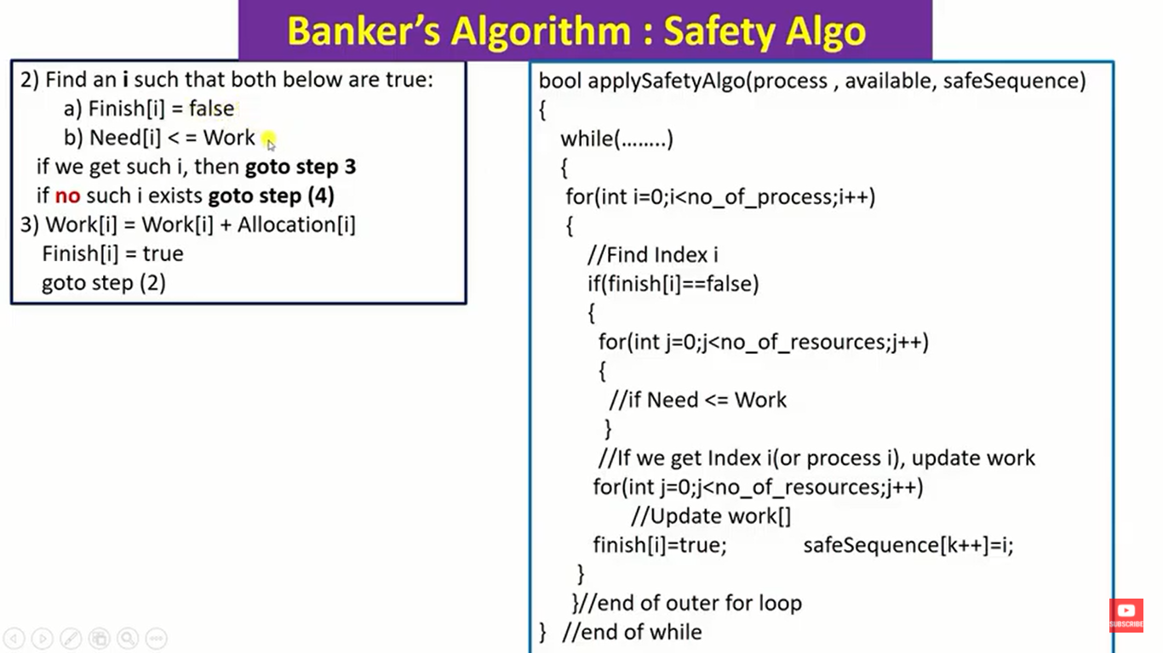

Slide 5
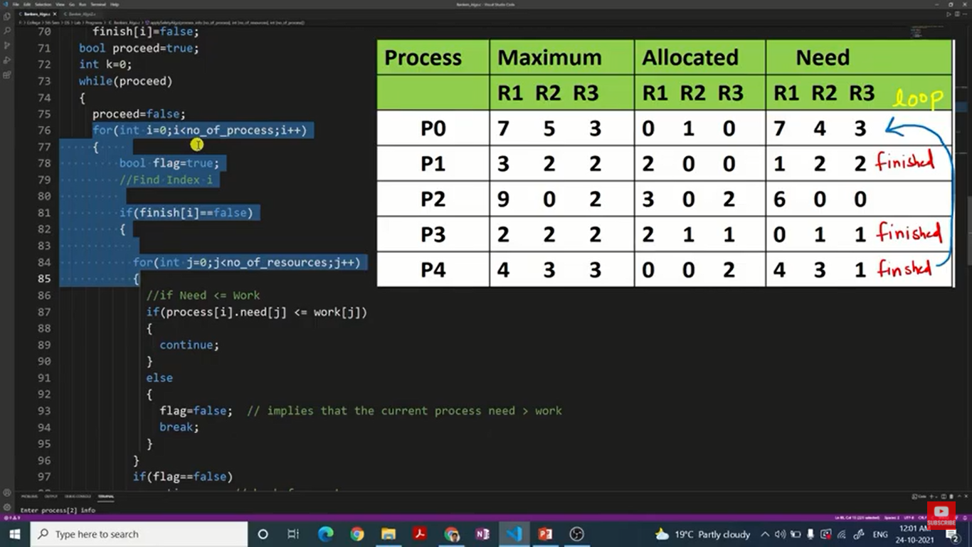
Notes:
https://github.com/DilipKumarGangwar/System-Programming-OS-Programs/blob/master/Bankers_Algo_Safety.c

